Slide 1


Introduction to Git & Version Control
Learn how software developers track changes, collaborate seamlessly, and save their code history with confidence.

Slide 2

What is Version Control?
Understanding why every tech professional uses version control to manage files and collaborate.

Slide 3


Why Do We Need Version Control?
The Old Way (Without Git)
The Git Way (With Version Control)
Creating messy duplicates like project_v1.zip, project_final.zip, and project_final_FINAL2.zip.
One single project directory. Every change is tracked as a clean timeline entry called a Commit.
Hard to know who changed what, zero undo safety net, and high risk of overwriting team members' hard work.
Easily travel back in time to any version, work on features safely in parallel, and merge team code without fear.

Slide 4










Git Core Architecture: The 3 States
1. Working Directory
2. Staging Area
3. Local Repository
Your actual local folder on your computer where you create, edit, and save files directly in your code editor.
The "waiting room" (Index). You choose specific changes to stage before officially snapshotting them.
The permanent history stored inside the hidden .git folder after you commit your staged files.
Working Dir
Staging Area
Local Repo

Slide 5
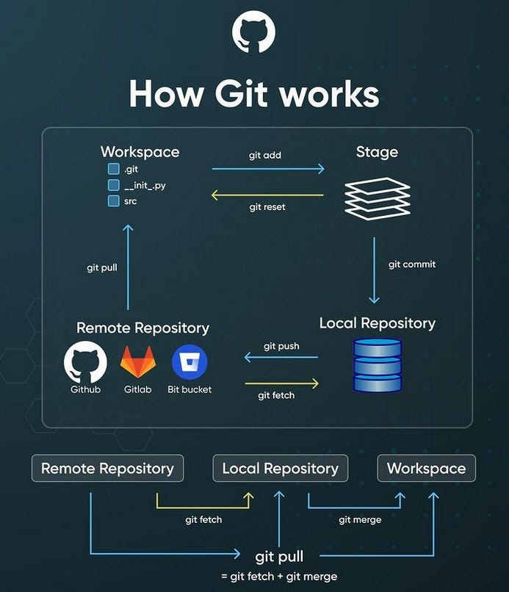
Distributed Version Control
Git is a Distributed Version Control System (DVCS) created by Linus Torvalds in 2005.
Unlike old centralized tools, every developer has a full copy of the entire project repository—including its complete history—on their local machine.
This means you can work completely offline, commit changes locally, and sync with others when connected!

Slide 6








The Basic 4-Step Git Workflow
Initialize
Stage
Commit
Push
Start tracking a folder using git init or copy an existing project with git clone.
Select altered files to prepare for a snapshot using git add file.txt or git add .
Save staged snapshot with a descriptive note: git commit -m "Add homepage banner"
Upload your local commits to a remote cloud host using git push origin main.

Slide 7

Essential Git Commands Cheat Sheet
Command | Action / Purpose | Example Usage
git init | Initializes a new Git repository in current folder | git init my-app
git status | Checks the state of working dir and staging area | git status
git add | Adds changed files to the staging area | git add index.html
git commit | Records staged snapshot permanently in history | git commit -m "Fix navbar link"
git log | Displays commit history timeline with details | git log --oneline

Slide 8




Git vs. GitHub: What's the Difference?
Git (The Engine)
A local command-line tool running on your computer that tracks file changes and maintains history.
GitHub (The Cloud Hub)
A web service that hosts Git repositories in the cloud for remote backup and team collaboration.

Slide 9
Branching: Parallel Universes for Code
Main Branch (Production): Holds the stable, working version of your code that users actually see.
Feature Branches: Create isolated copies (e.g., git checkout -b dark-mode) to test ideas safely without breaking main code.
Merging: Combine tested branch features back into main effortlessly using git merge feature-name.
Conflict Resolution: Git alerts you if two edits overlap, letting you review and choose the right code.

Slide 10


Class Assessment: Test Your Knowledge
Question 1
Question 2
Which command prepares your modified files for a commit?
Are Git and GitHub the exact same thing?
A) git commit
B) git add
C) git push
A) Yes, they are identical.
B) No, Git is local software and GitHub is a web host platform.

